Slide 1

Dietary Therapy for IBD
"No disease that can be treated by diet should be treated with any other means"
Maimonides (The Rambam) 1138–1204
Dr Nir Fireman
CME evening May 2021

Slide 2
Disclaimer-
I’m a paediatrician

Slide 3
Objectives
Dietary Therapy - Why/Who/When/What?
Mechanism of action – Role of Microbiota
Dietary patterns in Crohn’s Disease
Dietary recommendations in Ulcerative Colitis
CDED- Crohn’s Disease Exclusion Diet

Slide 4
Objectives
Dietary Therapy - Why/Who/When/What?
Mechanism of action – Role of Microbiota
Dietary patterns in Crohn’s Disease
Dietary recommendations in Ulcerative Colitis
CDED- Crohn’s Disease Exclusion Diet

Slide 5
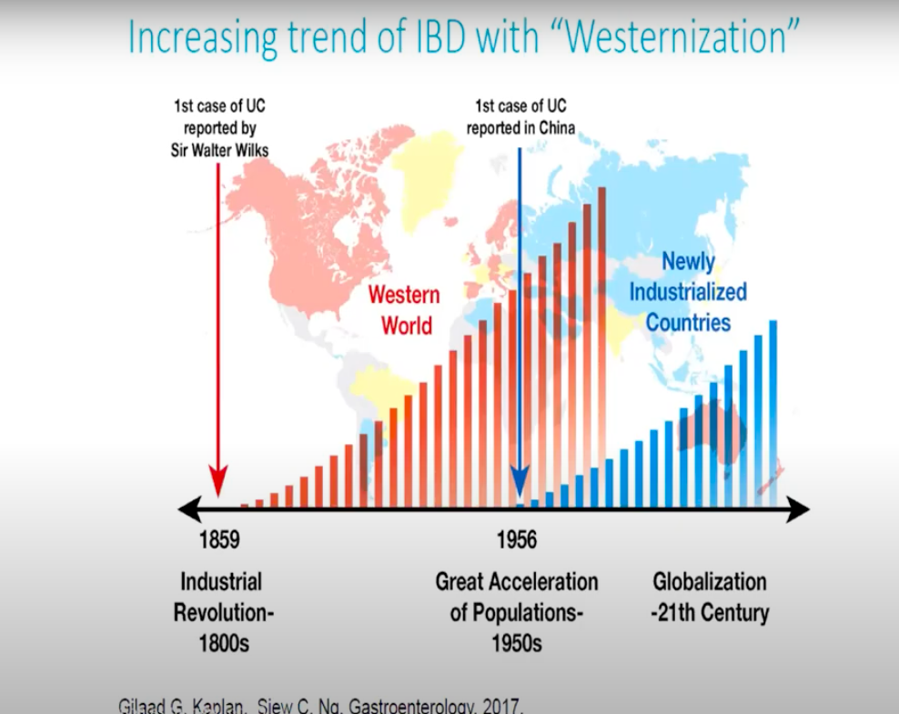
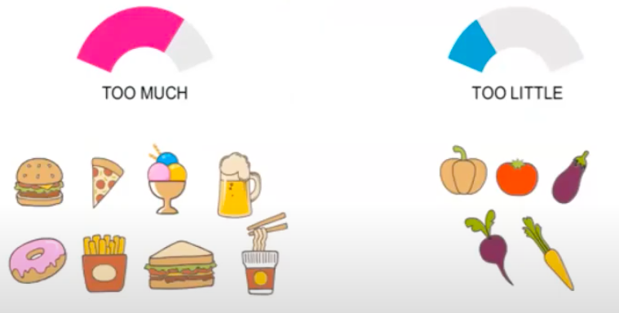
Trends in Epidemiology
Gilaad G Kaplan Gastroenterology 2017

Slide 6
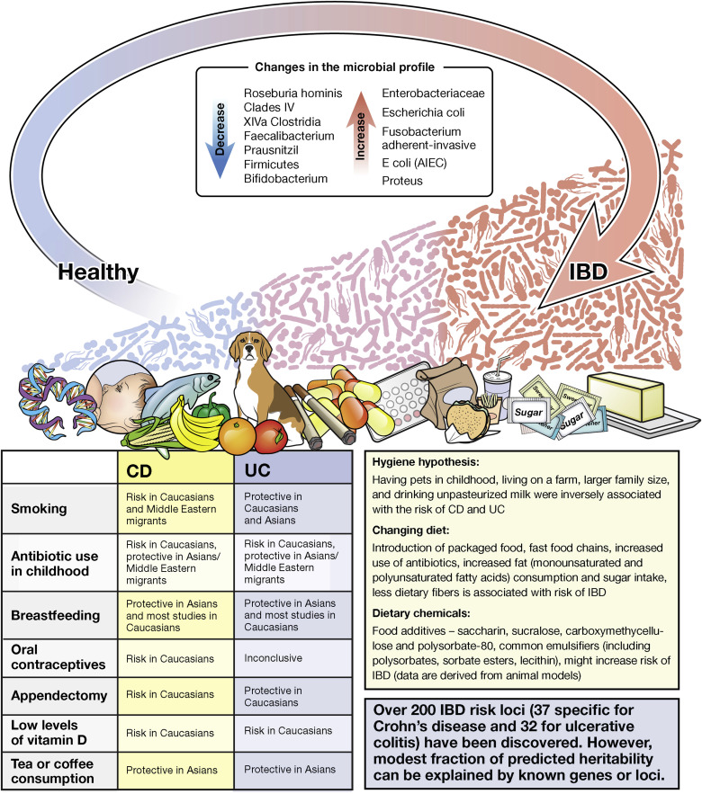
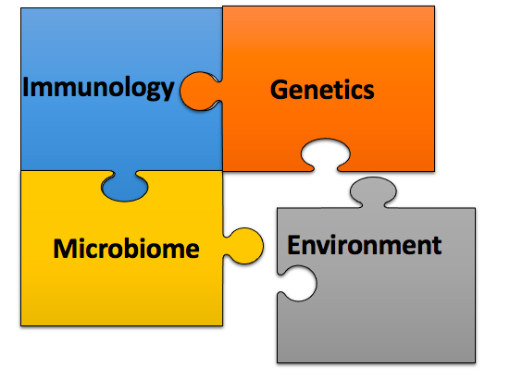
Gilaad G Kaplan Gastroenterology 2017

Slide 7

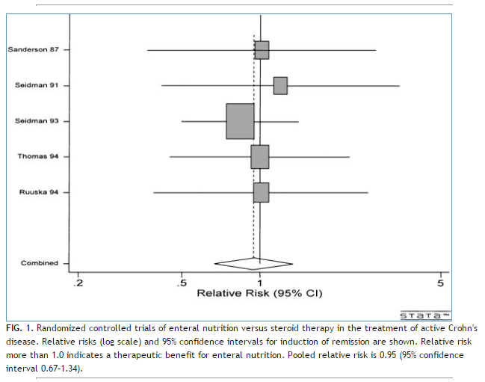
Efficacy of Exclusion Enteral Nutrition
Enteral Nutrition and Corticosteroids in the Treatment of Acute Crohn's Disease in Children
Meta analysis 5 RCT’s included EEN;
(RR = 0.95 [95% confidence interval 0.67, 1.34])
Heuschkel, Robert B et al. J Pediatr Gastroenterol Nutr. 2000 Jul;31(1):8-15.
Notes:
Enteral Nutrition and Corticosteroids in the Treatment of Acute Crohn's Disease in Children
Heuschkel, Robert B; Menache, Caroline C*; Megerian, J. Thomas*; Baird, Alison E*
Background: The optimal treatment of acute Crohn's disease in children remains controversial. In adults, steroid therapy has been shown to be superior to exclusive enteral nutrition. However, enteral nutrition is effective at inducing a remission in many children with acute Crohn's disease. Steroid usage in children has been associated with adverse side effects, particularly with delayed growth and pubertal development.
Methods: Randomized clinical trials comparing exclusive enteral nutrition with corticosteroids were identified. Two independent reviewers extracted data from selected studies. Studies were assessed for heterogeneity and relative risks for remission induction with enteral nutrition were obtained. Sensitivity analyses were performed in partially randomized studies. Estimates were made of the number of studies needed to overturn the current result. Other outcome measures were qualitatively assessed.
Results: In five randomized clinical trials comprising 147 patients, enteral nutrition was as effective as corticosteroids at inducing a remission (RR = 0.95 [95% confidence interval 0.67, 1.34]). Addition of two further nonrandomized trials did not significantly alter the result. A minimum of 10 further studies, equal in size and outcome to the largest reported pediatric trial to date (n = 68, RR = 0.84), would be required to demonstrate a significant benefit of steroid therapy over enteral nutrition.
Conclusions: There is no difference in efficacy between enteral nutrition and corticosteroid therapy in the treatment of acute Crohn's disease in children. Improved growth and development, without the side effects of steroid therapy, make enteral nutrition a better choice for first-line therapy in children with active Crohn's disease.

Slide 8
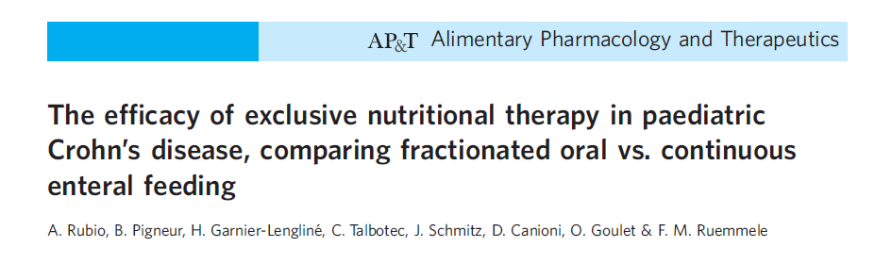
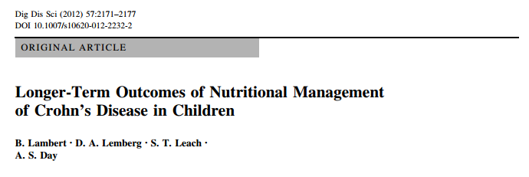
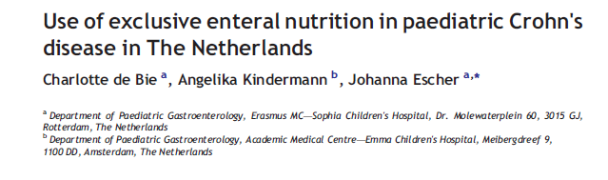
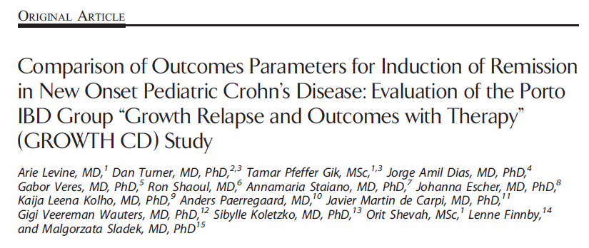
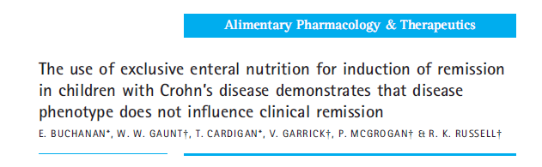
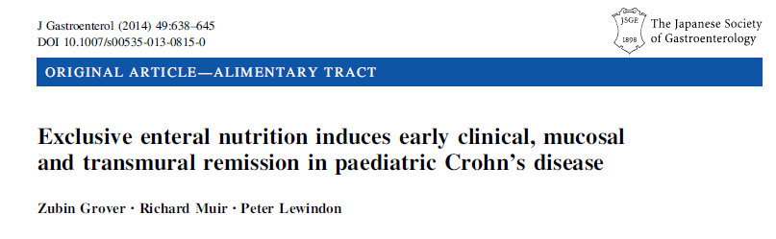
EEN for Induction of Remission

Slide 9
EEN for Induction of Remission
End Points | Remission Rate | Formulae | Number Design | Author/year
Clinical Remission PCDAI | 75-85% | Modulen | 106- retrospective 45 Oral /61 Tube | Rubio AP&T 2011
Clinical Remission PGA | 80% | Modulen | 114 -retrospective Response by Location | Buchanan AP&T 2009
Normal CRP Remission based stringent PCDAI | 79% remission 51% normal CRP remission | Variable Modulen | 222 -prospective Comparison steroids (114) vs EEN(43) | Levine IBD 2014
Relapse vs steroids Growth | 84% |  | 31 retrospective | Lambert Dis Dig Sci 2012
Mucosal healing | 64% ITT 84% PP |  | 34 prospective | Grover J Gastroenterol 2014
Clinical Remission | 71% PP | Variable | 51 retrospective Only those completing EEN | De Bie JCC 2013

Slide 10


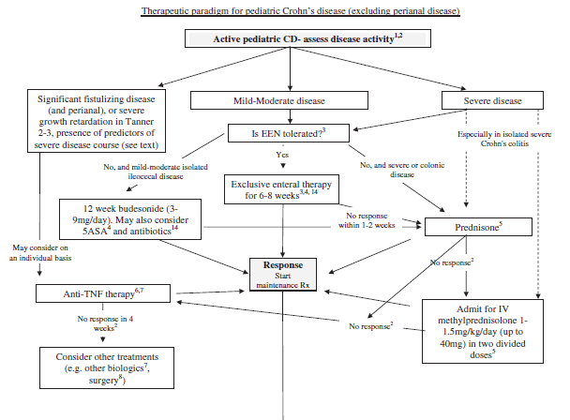


14 Years latter……
F.M. Ruemmelea, A. Levine et al. Journal of Crohn's and Colitis (2014) 8, 1179–1207

Slide 11
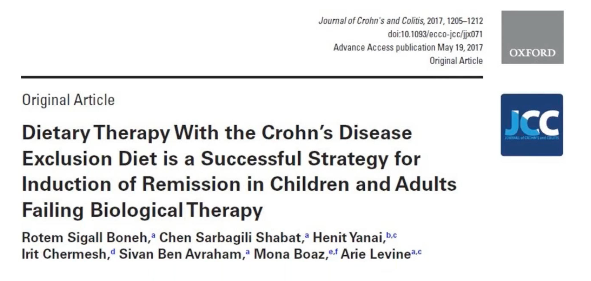

Slide 12
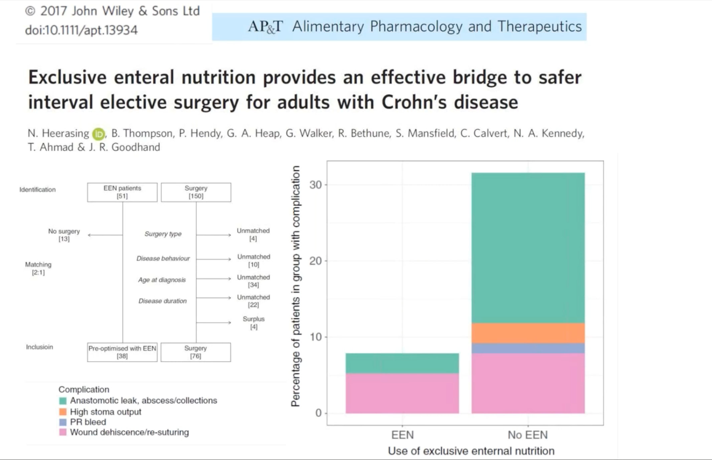

Slide 13
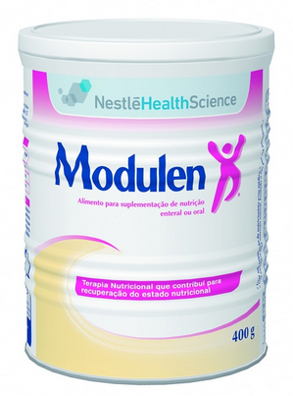
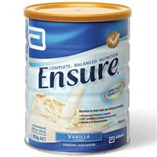

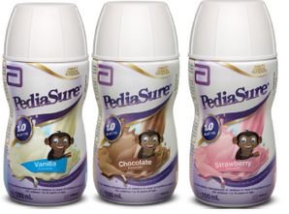


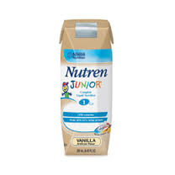
EEN- Exclusive Enteral Nutrition
100% of the caloric intake come from liquid diet
Polymeric formula works as well as elemental formula, with better compliance
6-8 weeks
60-85% remission rate
Mechanism??

Slide 14
Exclusive Enteral Nutrition 6-8 weeks
+ Avoid use of steroids
+Improves nutritional status
+ Improves Bone
+ Associated Mucosal Healing
+ No Side Effects
- Difficult for patients
- Difficult for Parents
- Difficult for Physician
- Demands Resources

Slide 15
Objectives
Dietary Therapy - Why/Who/When/What?
Mechanism of action – Role of Microbiota
Dietary patterns in Crohn’s Disease
Dietary recommendations in Ulcerative Colitis
CDED- Crohn’s Disease Exclusion Diet

Slide 16
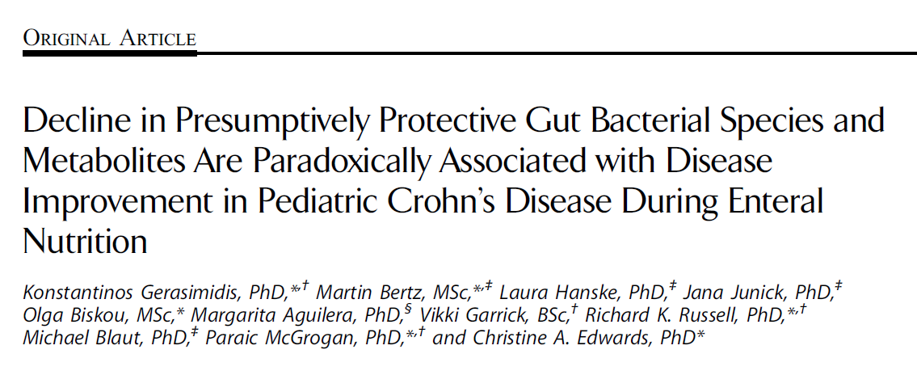
EEN- suggested Mechanism
Is it something we add to the diet?
  EEN Increase Diversity?
  Increase SCFA butyrate?
  Increase protective species?
Is it something we remove from the diet?
  Exclusion of harmful products
EEN decreases diversity
Decreases butyrate
Decreases protective species
Gerasimidis et al. Inflamm Bowel Dis 2014;20:861–871)
Notes:
.
Background: The gut microbiota is implicated in the pathogenesis of Crohn’s disease (CD). Exclusive enteral nutrition (EEN) is a successful
treatment, but its mode of action remains unknown. This study assessed serial changes in the fecal microbiota milieu during EEN.
Methods: Five fecal samples were collected from CD children: 4 during EEN (start, 15, 30, end EEN approximately 60 days) and the fifth on habitual
diet. Two samples were collected from healthy control subjects. Fecal pH, bacterial metabolites, global microbial diversity abundance, composition
stability, and quantitative changes of total and 7 major bacterial groups previously implicated in CD were measured.
Results: Overall, 68 samples were from 15 CD children and 40 from 21 control subjects. Fecal pH and total sulfide increased and butyric acid decreased
during EEN (all P , 0.05). Global bacterial diversity abundance decreased (P , 0.05); a higher degree of microbiota composition stability was seen in
control subjects than in CD children during EEN (at P # 0.008). Faecalibacterium prausnitzii spp concentration significantly decreased after 30 days on
EEN (P , 0.05). In patients who responded to EEN, the magnitude of the observed changes was greater and the concentration of Bacteroides/Prevotella
group decreased (P , 0.05). All these changes reverted to pretreatment levels on free diet, and EEN microbiota diversity increased when the children
returned to their free diet.
Conclusions: EEN impacts on gut microbiota composition and changes fecal metabolic activity. It is difficult to infer a causative
association between such changes and disease improvement, but the results do challenge the current perception of a protective role for
F. prausnitzii in CD.

Slide 17
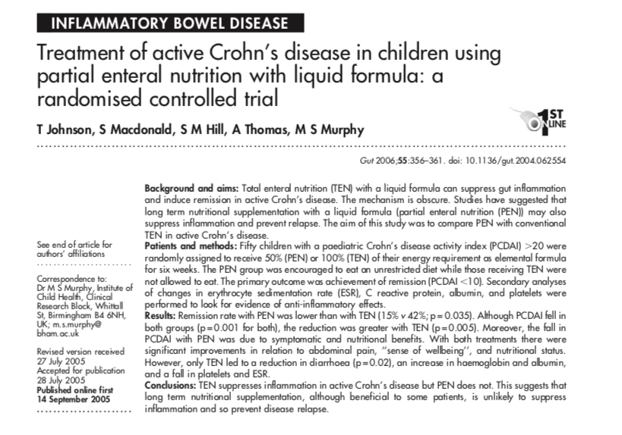
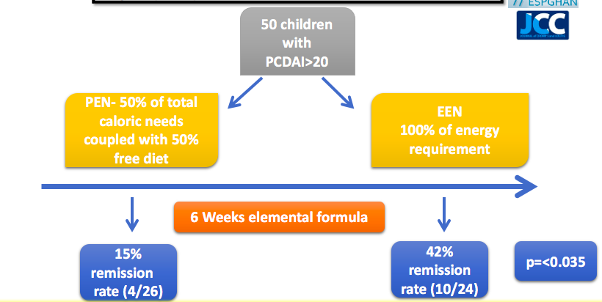
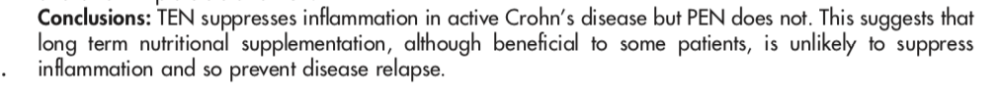

Slide 18
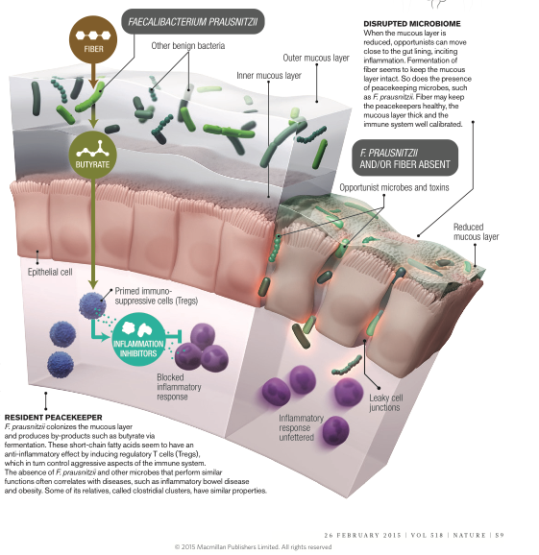
The intestine is the largest barrier from the outside world
Outer Mucous layer
Inner Mucous layer
Epithelial cells

Slide 19
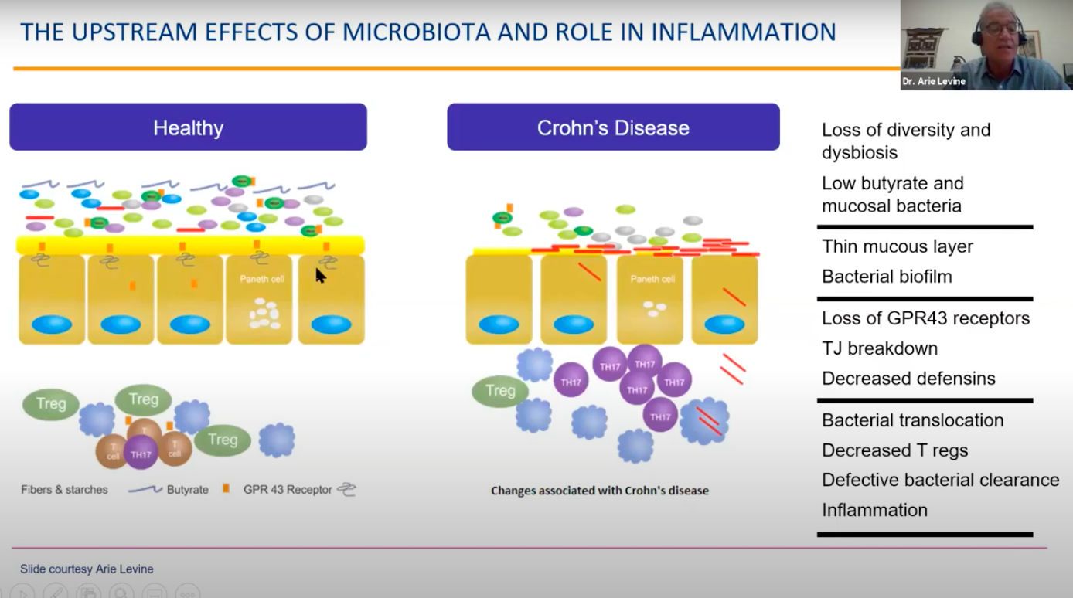
Mechanism of action – Role of Microbiota

Slide 20
Reference | Model | Effect | Dietary component
Devkota S, Nature, 2012 | IL 10–/– mice | Low diversity, Dysbiosis Presence of Bilophila wadsworthia | Milk Fats | Microbiome
Martinez M. Gut, 2014 | CEABAC 10 mice | Low diversity, Dysbiosis AIEC Colonization | High Fat + Simple sugars
Choi H, Toxicol Lett 2012 | HCT-8 cells, HT-29 Cells, Caco-2 Cells | Lowered Transepithelial resistance Discontinuous and irregular ZO-1 (zonula occludens) expression | Carrageenan (E407). | Intestinal Permeability (IP)
Martinez M. Gut, 2014 | CEABAC 10 mice | Claudin 2 over expressed | High Fat + Simple sugars
Suzuki T, Nutr Metab (Lond) 2010 | mutant obese Long-Evans rats | Dose dependent | High Animal Fat
Lamers, Gastroenterology 2008 Wagner et al Inflamm Bowel Dis 2013 | Human intestinal epithelial cell Caco2 cells IEC6 cells | Zonulin release, causes tight junction disassembly Increase Inflammation Ileum TNF Δ ARE/WT mouse | Gluten
Roberts C, Gut 2010 | M cells Caco2 Cells | AIEC translocated 15.8 folds higher | Polysorbate -80 (E433) | Adherence Translocation Biofilms
 |  | Lowered AIEC translocation | Plantain and Brocoli fiber
Swidsinski A , Inflamm Bowel Dis 2009 | IL 10–/– mice | Adherence | CMC (E466)
Nickerson KP, PLoS One 2012 | Human intestinal epithelial cell monolayers | Biofilms | Maltodextrin
Swidsinski A , Inflamm Bowel Dis 2009 | IL 10–/– mice | Bacterial overgrowth (30,000 folds ) especially between villi. | CMC (E466) | Mucous Layer
Martinez M. Gut, 2014 | CEABAC 10 mice | Decreased expression MUC2, Depleted Goblet Cells | High Fat + Simple sugars

Slide 21
Crohn’s Disease Pathogenesis- Link the Dots!
Dysbiosis
Intestinal
Permeability
Mucous Layer or
Bacterial Clearance
Defect
Adherence and Translocation
Bacteria

Slide 22
The Perfect Dietary Storm- Rodent Models
Partial List
High Animal Fat
Milk Fat
Sulfites?
Iron?
Gluten
High Fat
Alcohol
Emulsifiers
Maltodextrin
Low Plant Fiber
Dysbiosis
Intestinal
Permeability
Mucous Layer or
Bacterial Clearance
Defect
Adherence and Translocation
Bacteria

Slide 23
Objectives
Dietary Therapy - Why/Who/When/What?
Mechanism of action – Role of Microbiota
Dietary patterns in Crohn’s Disease
Dietary recommendations in Ulcerative Colitis
CDED- Crohn’s Disease Exclusion Diet

Slide 24

So which dietary pattern works?
Different whole food diets, trying to implicate the EEN concepts
  SCD: Specific Carbohydrates Diet
  CD-Treat: Crohn’s disease treatment with- eating diet
  FIT: Food Influence on the Intestinal Microbiota diet
  IBD Aid- Anti-Inflammatory diet
  Low- FODMAP
  Mediterranean Diet
  CDED- Crohn’s Disease Exclusion Diet

Slide 25
Overview of the diets being tested in inflammatory bowel disease with permitted and prohibited components.
J F Colombel Gastroenterology 2019

Slide 26
Overview of the diets being tested in inflammatory bowel disease with permitted and prohibited components.
J F Colombel Gastroenterology 2019

Slide 27
Overview of the diets being tested in inflammatory bowel disease with permitted and prohibited components.
J F Colombel Gastroenterology 2019

Slide 28
Overview of the diets being tested in inflammatory bowel disease with permitted and prohibited components.
J F Colombel Gastroenterology 2019

Slide 29
Objectives
Dietary Therapy - Why/Who/When/What?
Mechanism of action – Role of Microbiota
Dietary patterns in Crohn’s Disease
Dietary recommendations in Ulcerative Colitis
CDED- Crohn’s Disease Exclusion Diet

Slide 30
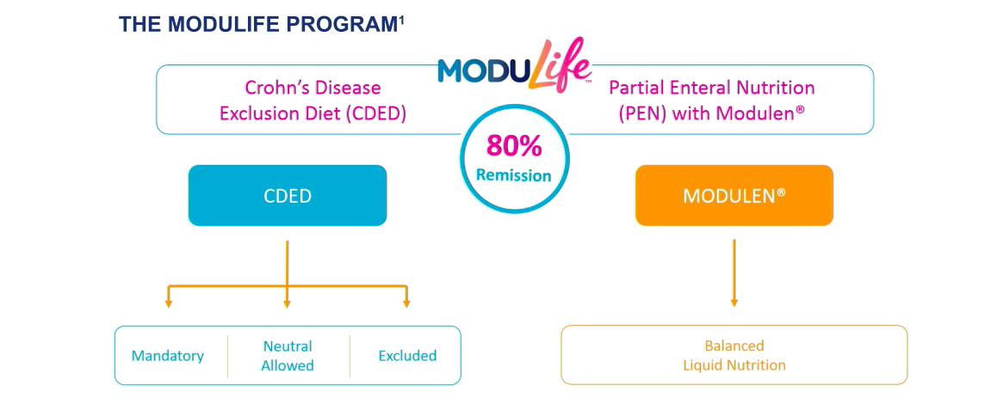
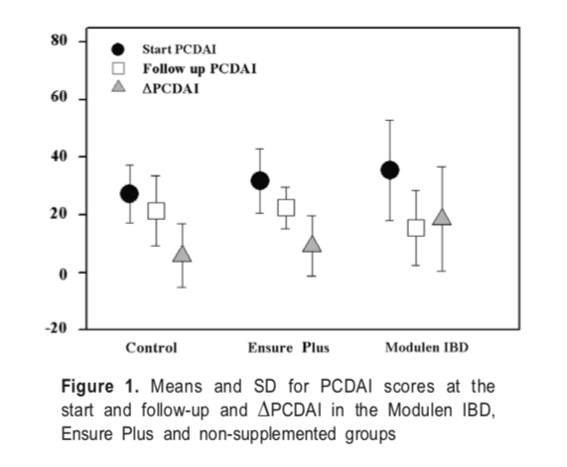
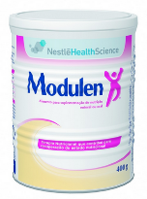
Modulen IBD® (Nestle) rich in TGF-β (transforming growth factor) polymeric liquid formula- Unavailable in NZ.
supplementation of the diet with Modulen as well as supplementation with Ensure Plus was associated with a decrease in PCDAI.
The children supplemented with Modulen also showed improvement in BMI

Slide 31
CDED- Crohn's Disease Exclusion Diet
Structured diet, a step-down diet
Overcome EEN challenges- Palatability and sustainability
Allowed and disallowed foods and products
Showed 70% remission rate in children and adults*
Exclusion of specific components
  Gluten
  Gluten free baked goods ,breads , Yeast
  Dairy products
  Animal fat
  Processed meats
  Products containing emulsifiers
  Low Sugar but not low carbohydrate diet
  *Sigall-Boneh R, Pfeffer-Gik T, Segal I, Zangen T, Boaz M, Levine A.Inflamm Bowel Dis. 2014
Notes:
And… This is a structured 12 weeks diet and it has 2 phases; the first 6 weeks are strict diet and the second 6 weeks are step down diet.
There are allowed and disallowed foods and products
And the diet excludes many of the components that Prof. Levine mentioned in his talk; these include:
Gluten
Gluten free baked goods ,breads , Yeast
Dairy products
Animal fat
Processed meats
Products containing emulsifiers
Low Sugar but this is not a low carbohydrate diet
Specifically, the diet does contain a good amount of fiber 18-20 grams per day and this is very different from what many people recommend early.

Slide 32
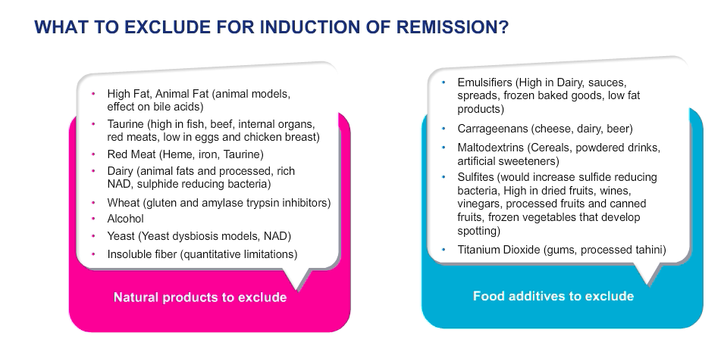

Slide 33
CDED
Phase 1 Week 0-6
50% Formula
Phase 2 Week 7-12
25% Formula

Slide 34
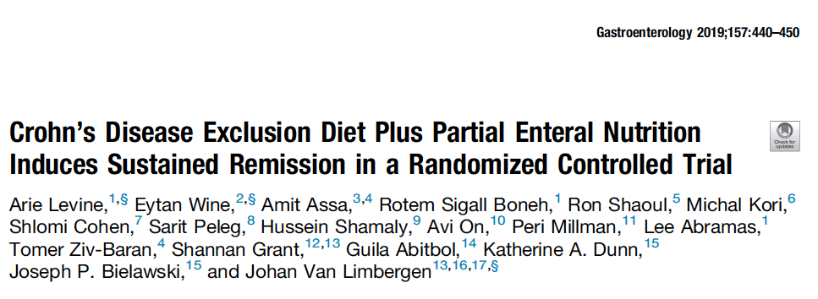
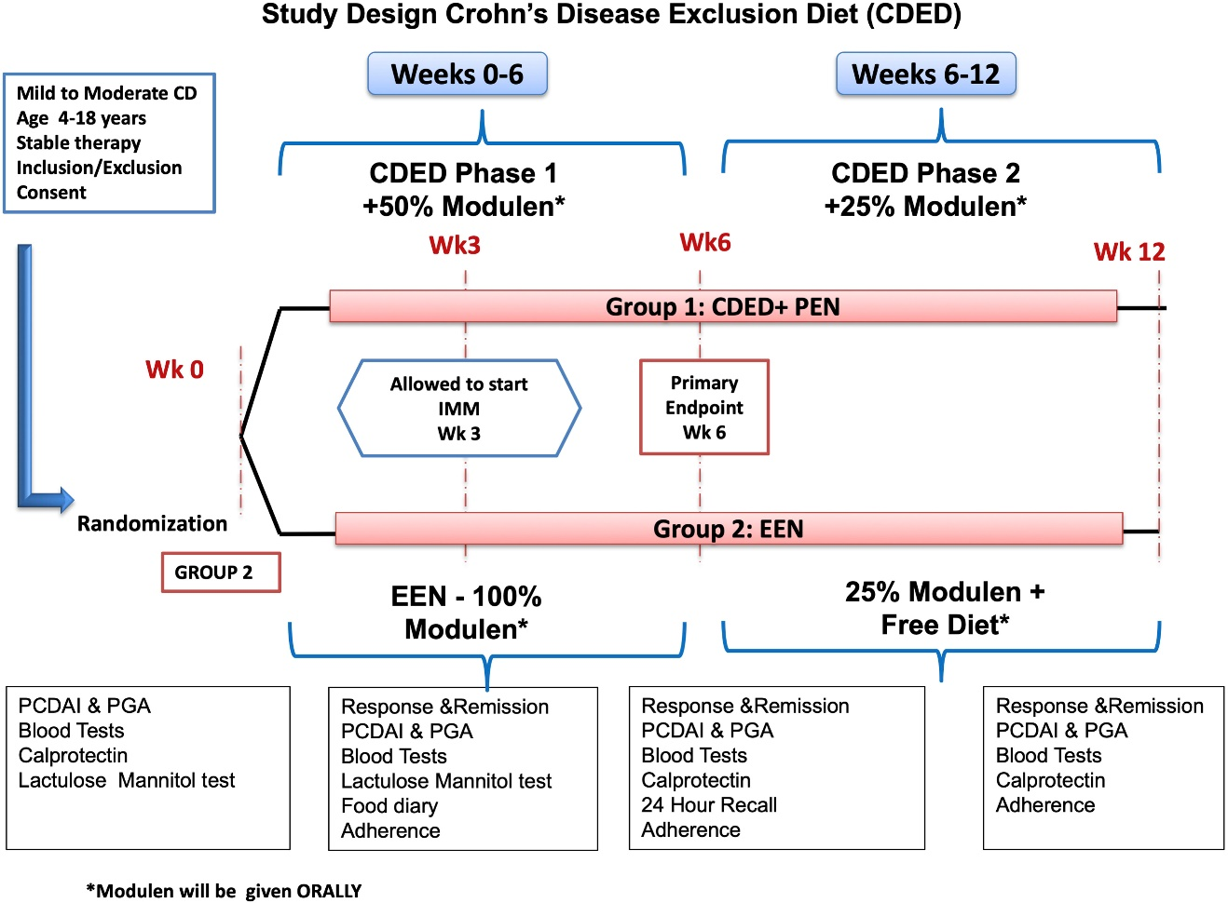

Slide 35
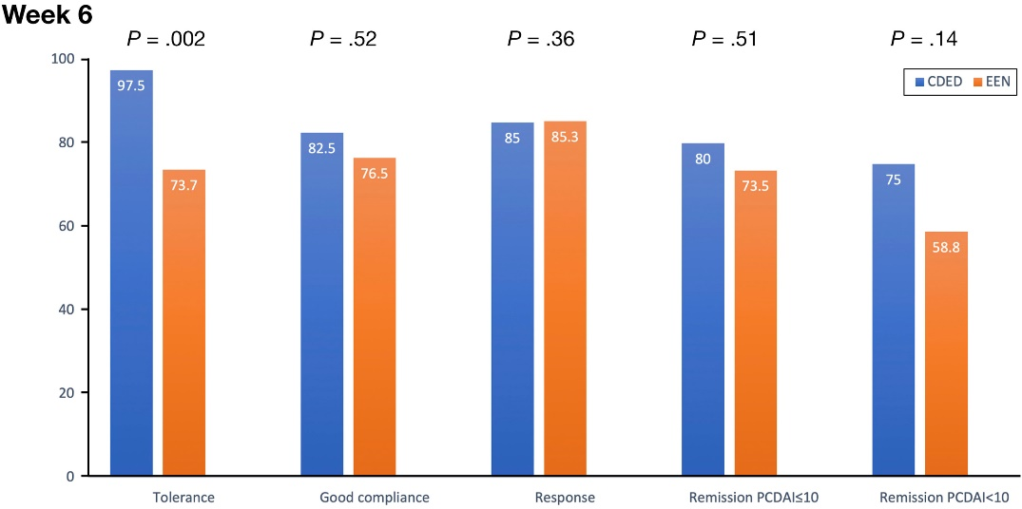
Both groups showed clinical remission and a significant decrease in inflammation by week 6.
The CDED group showed sustained remission in week 12
Gastroenterology 2019 157440-450.e8DOI: (10.1053/j.gastro.2019.04.021)

Slide 36
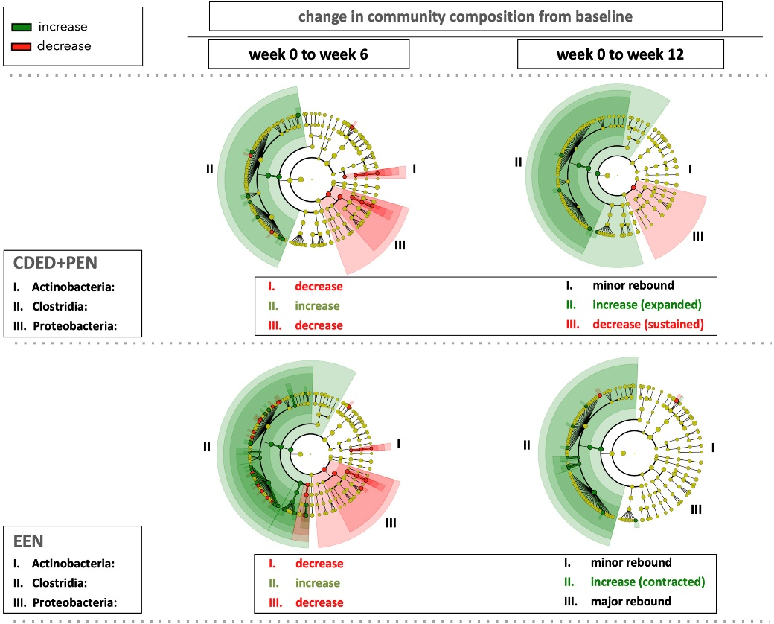
Sustained remission, and normal CRP remission at week 12 were significantly better in the CDED group.
Calprotectin continued to decrease between week 6 and week 12 in the CDED group, in contrast to an increase in the EEN group from week 6
Linear discriminant
analysis comparing
taxa in week 0 to week 6
and week 12
Change in median calprotectin during CDED study.
Gastroenterology 2019 157440-450.e8DOI: (10.1053/j.gastro.2019.04.021)

Slide 37
Objectives
Dietary Therapy - Why/Who/When/What?
Mechanism of action – Role of Microbiota
Dietary patterns in Crohn’s Disease
Dietary recommendations in Ulcerative Colitis
CDED- Crohn’s Disease Exclusion Diet

Slide 38
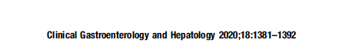
What about Ulcerative Colitis??
Mainly epidemiological data
?Similar to CD

Slide 39
Take home message
“Western Diet” is strongly associated with IBD.
In non complicated Paediatric Crohn’s disease and probably in adults as well, CDED is recommended.
Any diet reducing high fat, highly processed foods and rich in fruits and vegetable is likely to have some effect.
Dietary treatment may be used as a supplementary or bridge treatment in all patients.

Slide 40


